Slide 1
MOBILE SHOP MANAGEMENT SYSTEM
LRG GOVERNMENT ARTS COLLEGE FOR WOMEN
DHANYA.R,BSC COMPUTER SCIENCE (SHIFT 1)
GUIDE MAM: Dr KOKILA.P

Slide 2
ABSTRACT
A Mobile shop management system, this project has only one user, the admin is an owner of the shop, login into the application and using all the features. For example, the admin has several shops the single man can’t be handle the all the store in same time but this application can do it. Because this application connects all the store into a single application. He can see all the store details in a single hand. Admin can create a store and login into the application they can entries purchase and sales entry, based on this we can generate billing details, which provide all the details of the application. Which is very important to customize all these features in single application but admin can do this.
The main goal of this project is an connect all the store into a single application and managing all the lifecycle of the project. The project is aimed to develop by Python as Front end and MYSQL as Back end.

Slide 3
OBJECTIVES
The management objective of the mobile store system is to manage the details of Customers, Stock, Mobile, Payment, Sells.
It manages all the information about Customers, Brands, Sells, Customers.
It tracks all the details about the Mobile, Payment, Sales.

Slide 4
HARDWARE SPECFICATION
Processor : P 4 700 GHz.
RAM : 4 GB RAM
Hard Disk Drive : 180 GB

Slide 5
SOFTWARE SPECIFICATION
Operating System : Windows 7/8/10
Front End : PYTHON
Back End : MYSQL

Slide 6
EXISTING SYSTEM
In the existing system all transaction, dealing of products, purchasing of products were done manually which is time consuming. To buy any product user has to collect information about it either by visiting the shop or ask people which is the better one.
DRAWBACKS:
Very difficult to manage store
It takes more time to calculate daily reports
Too hard to find missing accessories and mobile phones.

Slide 7
PROPOSED SYSTEM
In this mobile store management system can easily solved these kind of issue. Which is very help to manage mobile shop. Manager can easily find the stock of mobiles and mobile accessories. Which is very help to avoid unwanted issues.
FEATURES:
Maintain the stock details
Managing the customer details
Managing the purchase and sales details

Slide 8
Modules
Customer Registration
Employee Registration
Purchase Mobiles and accessories Product
Sales Mobiles and accessories Product
Billing Details

Slide 9
Modules
Customer Registration
This module collects all the information about the customer like, mobile number, name and address etc… these fields are very help to getting further details about the customer. We can easily find out the regular customers.
Employee Registration
The module will help to store the information about the employees, it collects all the information and store into the employee table. This module collect salary, mobile number etc…

Slide 10
Purchase Mobiles and accessories Product
In this module owner will added purchased mobile phones and accessories. Admin should register before selling that product. Each and every product should enter in this module, then only calculate the stock details if some items are missing to register, we can’t get the exact stock report.
Sales Product
This module has used to register the product details before selling. So, we can identify the stock of product and billing details. Each and every sale will be store in the billing module, when enter the sales that item has reduce in the stock module.
Billing details
We can calculate billing details based on sales details. This module will generate billing details based on its sales. Billing details has shown the sales product details, it will be showing overall sales details report.

Slide 11

Data Flow Diagram
Level 0:

Slide 12
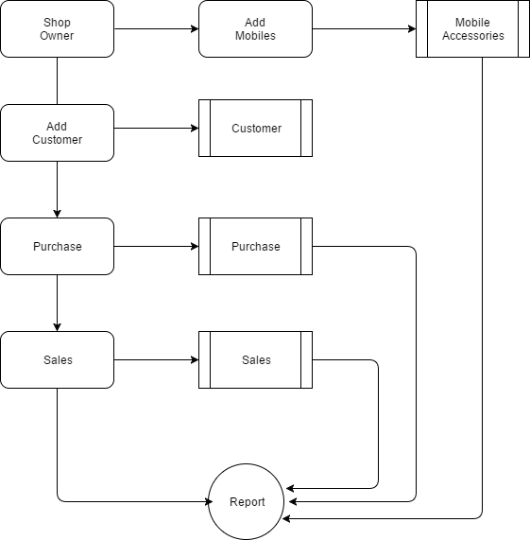
Level 1:

Slide 13
TABLE DESIGN TABLE NAME:ADMIN
FIELD | DATA TYPE | SIZE | CONSTRAINT
Admin id | Int | 10 | Primary key
Username | Varchar | 30 | Not null
password | Varchar | 30 | Not null

Slide 14
TABLE NAME:EMPLOYEE
FIELD | DATA TYPE | SIZE | CONSTRAINT
Employee id | Int | 10 | Primary key
Name | Varchar | 20 | Not null
Mobile | Int | 10 | Not null
Age | Int | 5 | Not null
Gender | Varchar | 6 | Not null
Salary | Int | 5 | Not null

Slide 15
TABLE NAME:CUSTOMER
FIELD | DATA TYPE | SIZE | CONSTRAINT
Id | Int | 10 | Primary key
Name | Varchar | 20 | Not null
Mobile | Int | 10 | Not null
Alternate | Int | 10 | Not null
Address | Varchar | 30 | Not null
Gender | Varchar | 10 | Not null

Slide 16
TABLE NAME:MOBILE
FIELD | DATA TYPE | SIZE | CONSTRAINT
Mobile id | Int | 10 | Primary key
Mobile model | Varchar | 20 | Not null
Mobile brand | Varchar | 20 | Not null
Price | Int | 5 | Not null
RAM | Int | 5 | Not null
CAMERA PX | Int | 5 | Not null
STORAGE | Varchar | 10 | Not null

Slide 17
TABLE NAME:PURCHASE
FIELD | DATA TYPE | SIZE | CONSTRAINT
Purchase id | Int | 10 | Primary key
Product id | Int | 10 | Foreign key
Quantity | Int | 5 | Not null
Details | Varchar | 30 | Not null
Date | Date | 10 | Not null

Slide 18
TABLE NAME:SALES
FIELD | DATA TYPE | SIZE | CONSTRAINT
Sales id | Int | 10 | Primary key
Customer id | Int | 10 | Foreign key
Product id | Int | 10 | Foreign key
quantity | Int | 5 | Not null

Slide 19
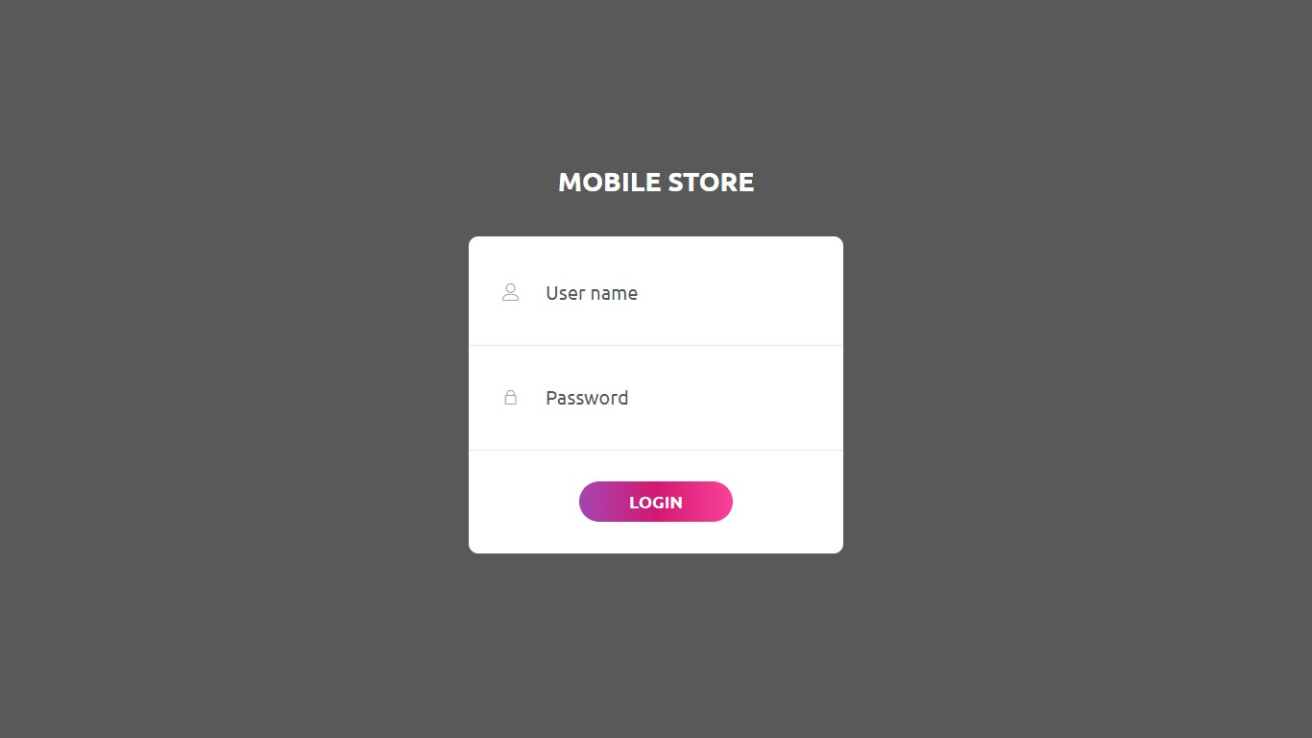
LOGIN PAGE

Slide 20
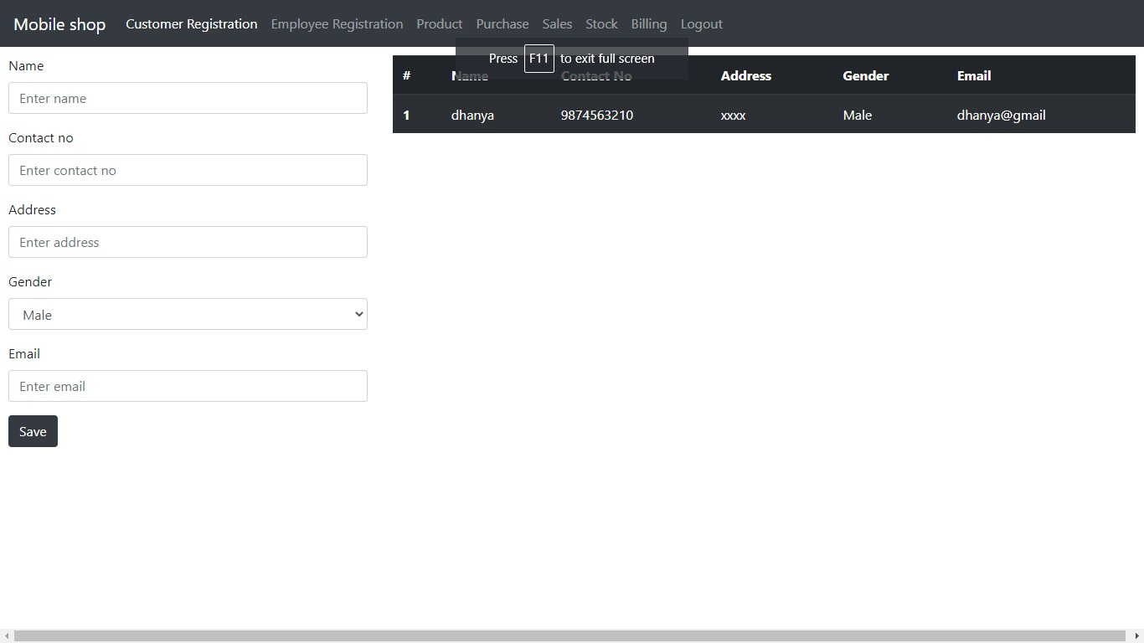
CUSTOMER REGISTRATION

Slide 21
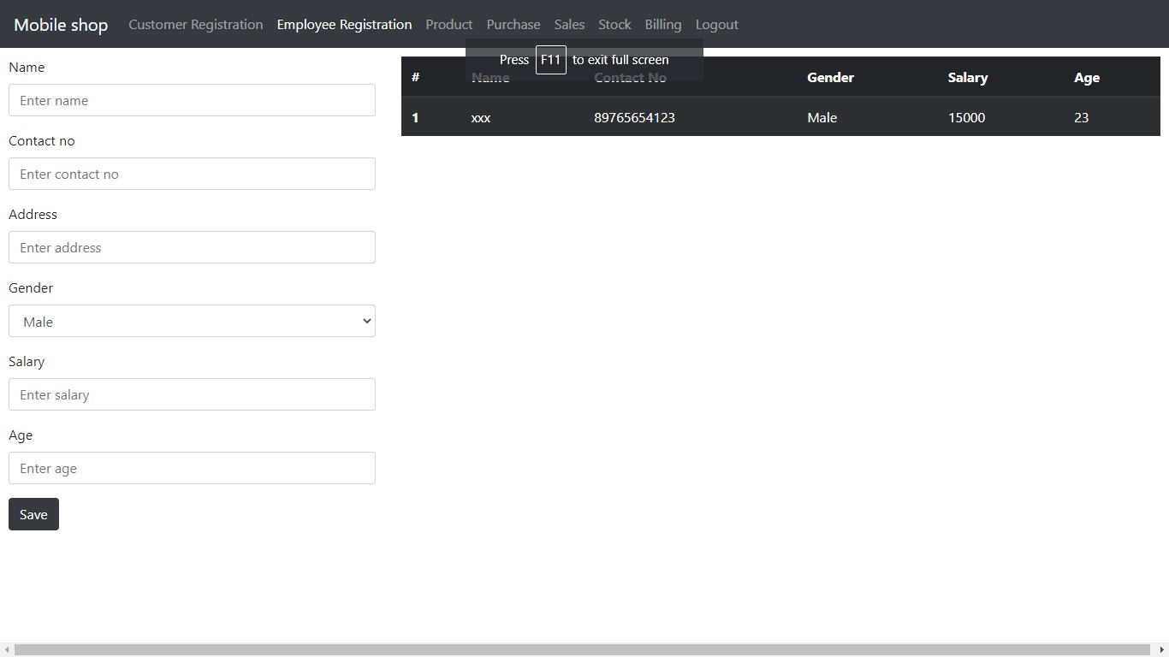
EMPLOYEE REGITRATION

Slide 22
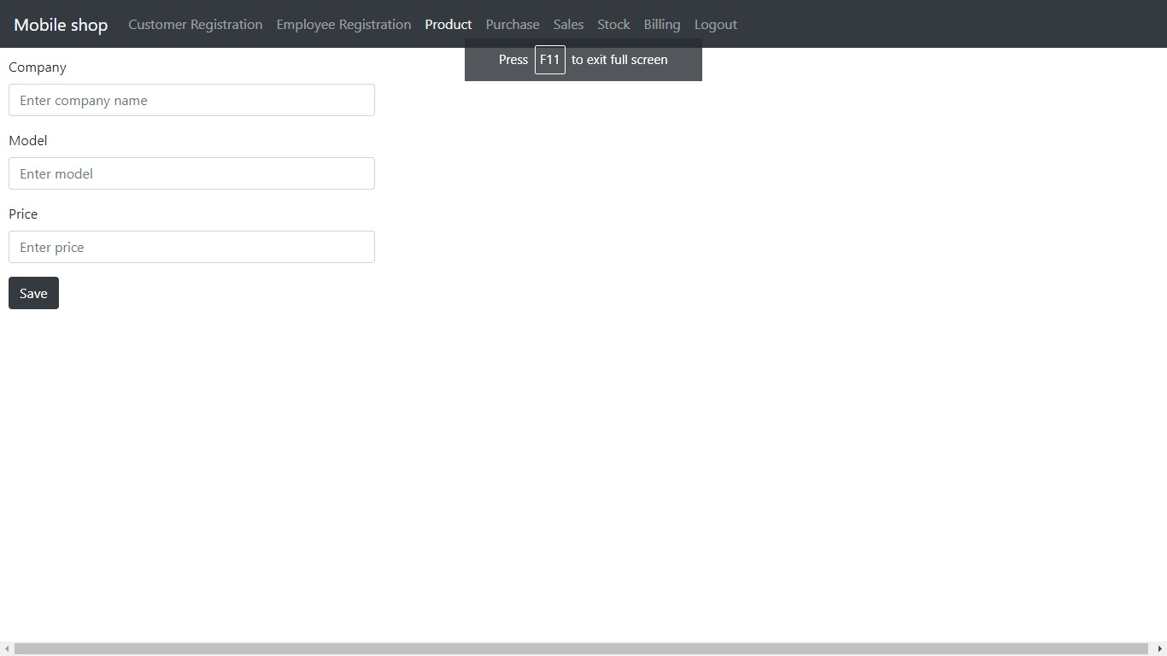
PRODUCT DETAILS

Slide 23
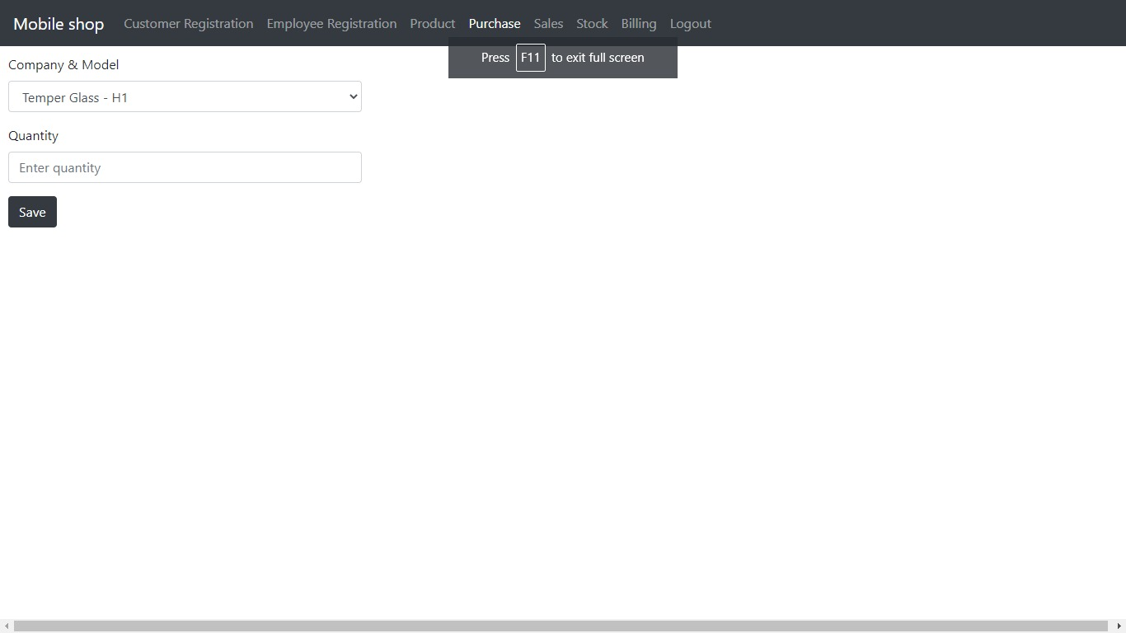
PURCHASE DETAILS

Slide 24
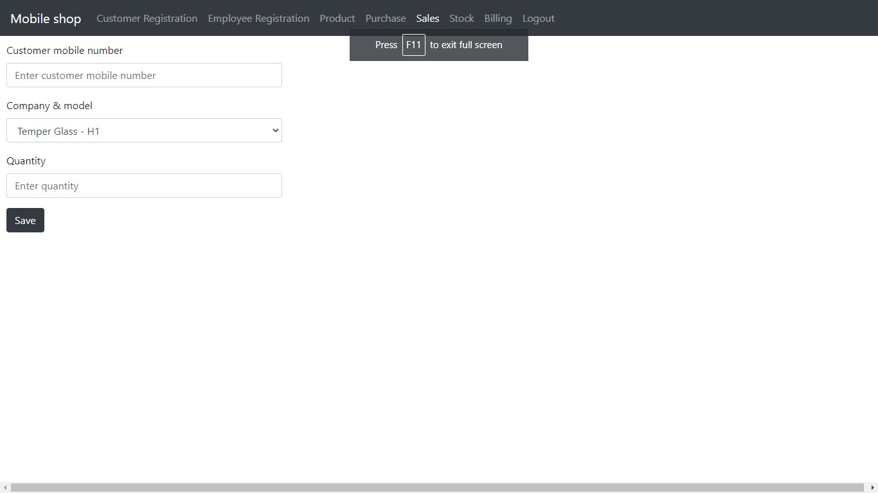
SALES DETAILS

Slide 25
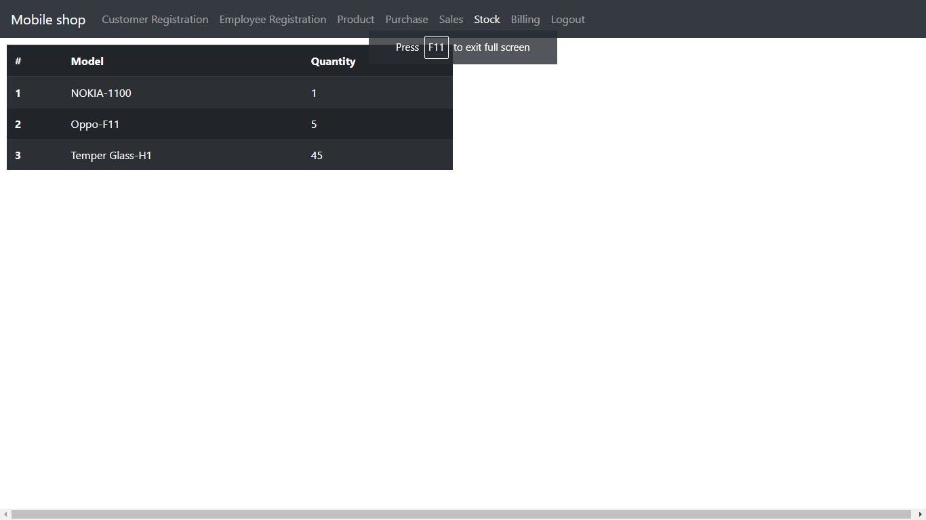
STOCK DETAILS

Slide 26
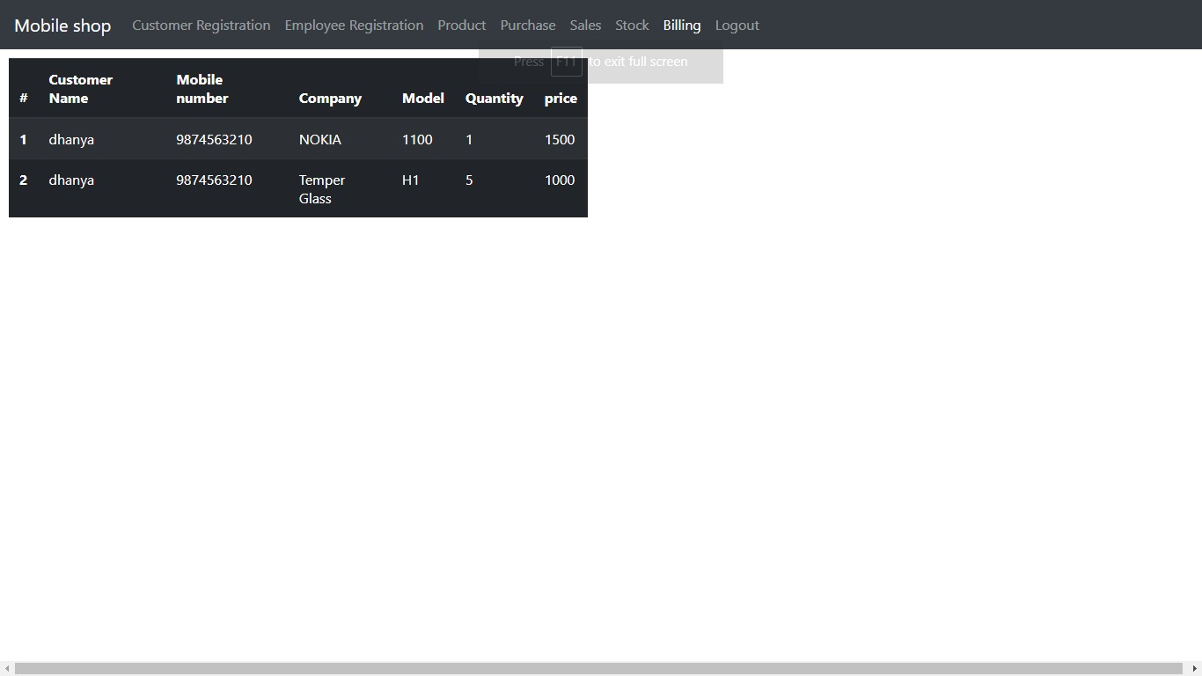
BILLING DETAILS

Slide 27
Thank You

